Slide 1
Smooth Operator: The WF Rules Engine interacting with WCF
Donn Felker
Senior Consultant at Magenic
MCTS / Scrum Master / ITIL Certified
blog.donnfelker.com
Twitter.com/donnfelker
donnf@magenic.com
Notes:
1

Slide 2
Who is Magenic?
Premier Microsoft Solutions Provider
Gold Partner of the year 2005
Gold Partner of the year runner up 2007
Looking for a change of pace? We’re hiring. ☺

Slide 3
The Rundown (agenda)
The Client interaction
Current State of Rules Processing
Examples
The Workflow Rules Engine
Demo
Exposing through WCF
Questions
Links / Example-Source Download

Slide 4
The Client Interaction
Yesterday: Here are the specs. This is final (right, sure)
Today: We need the app to do ‘A’.
Tomorrow: Hey, we also need it to do ‘B’
Next Week: Oh yeah, I know you’re almost finished, but we also need: ‘C’ . kthxbye. ☺
The only constant is change

Slide 5
What are people doing now?
“Rolling their own” - Homegrown custom Rules Engines
Programming it into every piece of software they have
… going through a lot of pain.

Slide 6
We’ve all written code like this …
public void ProcessOrder(IOrder order)
{
switch (order.Customer.MembershipLevel)
{
case MembershipLevel.Platinum:
// ... do some platinum member work
break;
case MembershipLevel.Gold:
// .. do some gold member work
break;
default:
// case MembershipLevel.
// Silver fall into default.
// aka: standard members
// do some ... standard member ... work.
break;
}
}

Slide 7
New Features – More Code Changes
Update the existing code base with the new rules.
  Client: “When a customer purchases over $10,000 in product they should be treated with a Platinum level of service.”

Slide 8
Adding new features – V2
public void ProcessOrder(IOrder order)
{
// If customers order total over 10K,
// give them super duper
// platinum level service. Heck, roll out the red carpet.
if (order.OrderTotal >= 10000)
{
order.Customer.MembershipLevel = MembershipLevel.Platinum;
}
// ... switch statement ... etc
}

Slide 9
New Features – More Code Changes Part 2!!
Update again ...
  Client: “I forgot to tell you - when a customer purchases over 1,000 items they should be treated with a Platinum level of service as well...”

Slide 10
Changes – now we’re in V3 already
public void ProcessOrder(IOrder order)
{
// ... order total upgrade ...
// Total Quantity updgrade
if(order.TotalQuantity >= 1000)
{
order.Customer.MembershipLevel = MembershipLevel.Platinum;
}
// ... switch statement ...
}

Slide 11
New Features – again … #3…
Update again ...
  Client: “One more thing! When a customer orders 100 or more different line items they should be treated with a Platinum level of service as well...”

Slide 12
Changes – V4 … this is getting old..
public void ProcessOrder(IOrder order)
{
// ... order total upgrade ...
// .. total quantity upgrade
// Total Line Item Quantity Upgrade
if(order.LineItems.Count >= 100)
{
order.Customer.MembershipLevel =
MembershipLevel.Platinum;
}
// ... switch statement ...
}

Slide 13
Introducing Agility …
How do we introduce some flexibility into our rules engine to allow it to change without recompilation?
How can we do this ?????

Slide 14
Use The Windows Workflow Rules Engine
Pros:
  Allows for easy customization of rules
  Can externalize the rules outside of an assembly
  Can edit “on the fly”
Cons:
  No LINQ Queries
  To test requires an integration test. (Connect to file/db to get rules definition). *
  Learning curve.
  Difficult to debug (sometimes) – Trace files

Slide 15
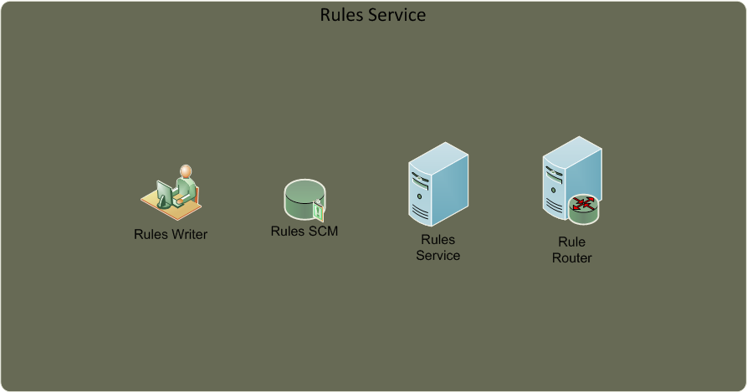

Rules and Service Usage

Slide 16
The beginning of a Paradigm Shift …
Application “Wants”:
  Scalability
  Easy to change rules
  Easy to add rules*
    This “might” require a code change “it depends”
  Ability to handle different orders with different types of service
    Platinum
    Gold
    Silver (Standard)

Slide 17
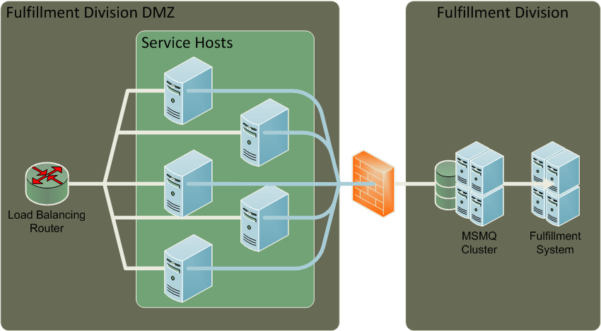

Architecture - Birds Eye View

Slide 18
Demo

Slide 19
Summary
You too can …
Win the war on rules engines.
(and learn Workflow along the way…)

Slide 20
Resources and Links
Books:
  Learning WCF (Bustamante): http://is.gd/3T8w
  Windows Workflow (K. Scott Allen) – http://is.gd/3T8M
  Pro WF (Bukovics) - http://is.gd/3T8J
WCF/WF Sample Downloads: http://is.gd/3T93
My blog : http://blog.donnfelker.com
Follow me on twitter: http://www.twitter.com/donnfelker
Email: donnf@magenic.com or donn@donnfelker.com

Slide 21
Q & A

