Slide 1
ASP. NET MVC2

Slide 2
  About
Donn Felker | Ind. Consultant | Agilevent
donn@donnfelker.com [email]
blog.donnfelker.com [blog]
@donnfelker [twitter]
  Involvement
Microsoft ASP Insider | MCTS, MCP | Scrum Master
Twin Cities Dev. Guild | TwinCitiesDevelopersGuild.com
Twin Cities GiveCamp | TwinCitiesGiveCamp.org
Twin Cities Pragmatic Beer | TwinCitiesPragmaticBeer.com
.NET Dime Casts | DimeCasts.net

Slide 3
EXPECTATIONS
{ YOU HAVE EXP. WITH MVC }
{ THIS IS NOT A “WHAT IS MVC” TALK }
(however … I would be happy to answer questions about HOWTO scenarios after the presentation)

Slide 4
MVC 2 NEW STUFF
TOOLS
VS2010 / MVC2 RC2
RESHARPER EAP 5.0

Slide 5
UPGRADING TO MVC2
EXPRESSION BASED HELPERS
AREAS
VALIDATION
LIST BINDING
DEFAULT VALUE PARAMETERS
UI HINT
DISPLAY & EDITOR TEMPLATES
ASYNC CONTROLLER

Slide 6
EXAMPLE APP
CODE CAMP
EVALS

Slide 7
UPGRADING TO MVC 2
2 WAYS TO MVC2
AUTOMAGICALLY
&
MANUAL

Slide 8
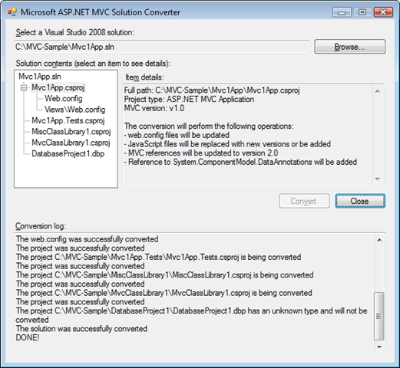
AUTOMAGICALLY
EILON LIPTONS MVC 2 CONVERTER
http://bit.ly/mvc2converter

Slide 9
MANUAL
Update references to 2.0
Binding Redirect from 1.0 to 2.0
[Copy Scripts]
Compile App fix any errors
Backup of the existing project.
Replace Project Type Guids
Web.config: replace System.Web.Mvc 1.0 with 2.0
Repeat with Web.config in views folder

Slide 10
MANUAL | LONG BUT THOROUGH
http://bit.ly/Mvc2Upgrade

Slide 11
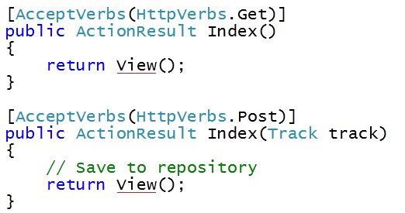
CONTROLLER ACTION VERBS
{ IMPROVEMENTS }

Slide 12
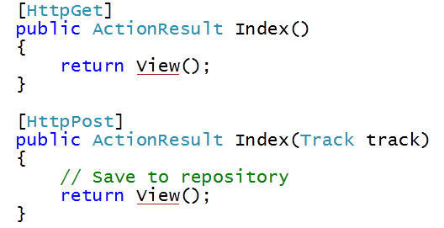
CONTROLLER ACTION VERBS
{ IMPROVEMENTS }

Slide 13
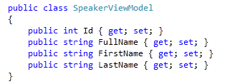
EXPRESSION BASED HTML HELPERS

Slide 14
EXPRESSION BASED GOODNESS
EXAMPLE
<%= Html.TextBoxFor(x => x.FirstName) %>
OTHER HELPERS
TextBox, Label, Hidden, CheckBox, Display, Editor
Notes:
Why Unit Test?
What

Slide 15
STRONGLY TYPED HTML HELPERS
DEMO
Notes:
Why Unit Test?
What

Slide 16
EDITOR & DISPLAY TEMPLATES
CUSTOM FUNCTIONALITY MADE EASY
Notes:
Why Unit Test?
What

Slide 17
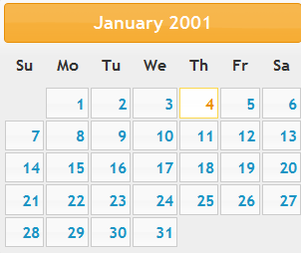
DISPLAYING ALL DATES
With jQuery’s DatePicker
Notes:
Why Unit Test?
What

Slide 18
EDITOR & DISPLAY TEMPLATES
DEMO

Slide 19
LIST BINDING MADE EASY
THE EDITABLE GRID
Notes:
Why Unit Test?
What

Slide 20
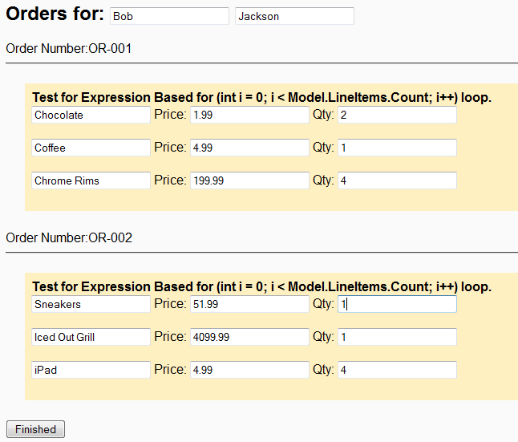
THE GRID
Notes:
Why Unit Test?
What

Slide 21
LIST BINDING | EDITABLE GRID
DEMO
Notes:
Why Unit Test?
What

Slide 22
VALIDATION DATA ANNOTATIONS
BUILT IN VALIDATION
Notes:
Why Unit Test?
What

Slide 23

PREVIOUS VALIDATION
CUSTOM MODEL BINDERS / CONTROLLERS / ETC
(validation taking place in a custom model binder)
Notes:
Why Unit Test?
What

Slide 24
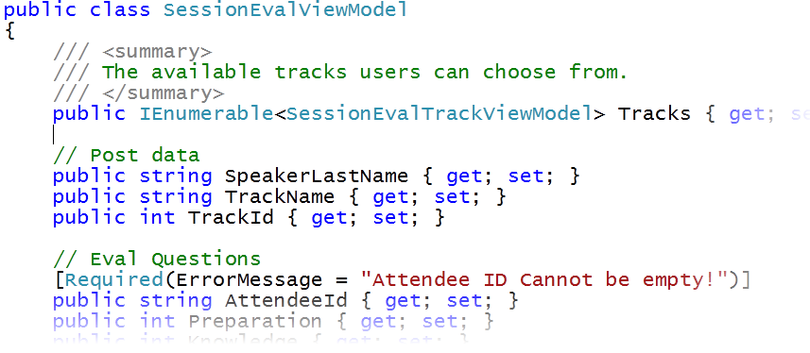
UPDATED VALIDATION
ATTRIBUTE BASED VALIDATION
Notes:
Why Unit Test?
What

Slide 25
DATA ANNOTATIONS
DEMO
Notes:
Why Unit Test?
What

Slide 26
DEFAULT VALUES FOR ACTIONS
DECORATING ACTION PARAMETERS
Notes:
Why Unit Test?
What

Slide 27

DefaultValueAttribute
PRIMITIVE TYPES OR POCO
Notes:
Why Unit Test?
What

Slide 28
SEPARATION OF CONCERNS
{ PROJECT AREAS }
Notes:
Why Unit Test?
What

Slide 29
SINGLE PROJECT
MULTIPLE PROJECT
Notes:
Why Unit Test?
What

Slide 30
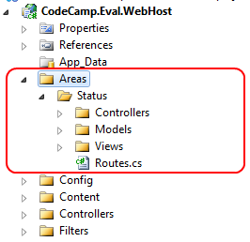
SINGLE PROJECT
AREAS EXIST IN THE SAME MVC2 PROJECT
Notes:
Why Unit Test?
What

Slide 31
MULTIPLE PROJECT
AREAS EXIST IN DIFFERENT MVC2 PROJECTS
REMOVED FROM MVC2
{ MOVED INTO MVC FUTURES }
Notes:
Why Unit Test?
What

Slide 32
SINGLE PROJECT AREAS
DEMO
Notes:
Why Unit Test?
What

Slide 33
ASYNC CONTROLLLERS | EDGE CASE
FOR HIGH PERFORMANCE SITES
Notes:
Why Unit Test?
What

Slide 34
THE EDGE CASE
INTENDED TO BOOST SERVER CAPACITY
PROCESS :
MVC CONTROLLER REQUEST STARTS
CONTROLLER CREATES A BLOCKING CALL SUCH AS A SQL DB CALL
MVC RELEASES THREAD BACK TO ASP.NET WORKER PROCESS THREAD POOL
WHEN BLOCKING CALL COMPLETES, MVC GRABS A FREE WORKER THREAD, REATTACHES HTTPCONTEXT, COMPLETES REQUEST
IN DEPTH INFO BY S. SANDERSON & R. CONERY
http://bit.ly/Mvc2AsyncControllers
http://tekpub.com/preview/aspmvc
Notes:
Why Unit Test?
What

Slide 35
Thank You
Notes:
Why Unit Test?
What

Slide 36
UPCOMING EVENTS
APR. 6th | TC Dev Guild |Android Dev. for .NET Developers
APR. 10th | TC Code Camp | Introduction to Android Dev.
~1-2 Wks| TekPub | Developing an Android Application
DONN FELKER
donn@donnfelker.com | email
blog.donnfelker.com | blog
Presentation will be available within 24 hours on my blog
Notes:
Why Unit Test?
What

